Slide 1
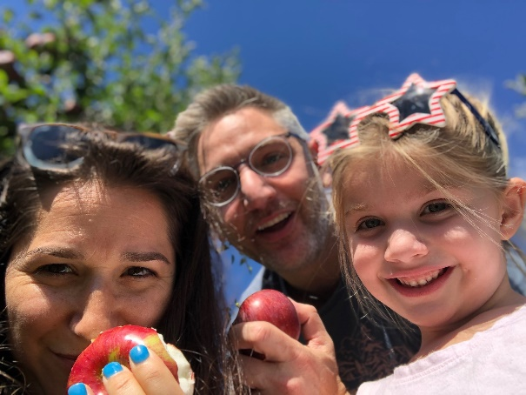
Drew Seelig
Cut to the chase..
About me: I love to travel and enjoy new food experiences. Avid IOTs researcher, deal finding, and fast walking. Stay to the right! Recently went to Louisville and now an avid Bourbon fan.
Superpower: Cleanliness Manipulation
Inspired by: Entrepreneurs ability to take risks that seem dumb, but prove to be successful.
Where you might find me: At the pool, in the garden, watching the Yankees, PSU Football (hopefully winning), listening to podcasts, cleaning up after my daughter, buying stuff for my daughter, play with the stuff I bought for my daughter.
Team characteristics that motivate me:
New ways of looking at problems
Strong communication and opinions
Willingness to solve problems with little direction
Team characteristics that de-motivate me:
Not asking questions, being silent or not having an opinion
Don’t follow through on commitments or provide updates
Being disinterested
"Baseball is 90 percent mental. The other half is physical.“
– Yogi Berra

